Slide 1

CAMPUS CONNECT - MVGR
FROM THE STUDENTS,
BY THE STUDENTS,
TO THE STUDENTS!!

Slide 2

PROBLEM STATEMENT:
DESIGN A WEB BASED COLLEGE WEBSITE
FOR THE PROSPECTIVE STUDENTS THAT
SHOWCASE COLLEGE’S KEY FEATURES ,
DEPARTMENTS,FACILITIES,
EVENTS AND ADMISSION INFO.

Slide 3
Senior to Junior
EXPERIENCE
Its a friendly website where in the currently admissioned students are going to share their point of views.
THIS PLATFORM ALLOWS THE NEW COMERS TO FEEL MORE COMFORTABLE. ITS JUST LIKE THE LAST MINUTE LESSON WE PREACH TO OUR FRIENDS FOR EASY UNDERSTANDING.
INTERACTION
THIS WOULD EXACTLY BRING NEWCOMERS TO A IDEA OF HOW COLLEGE WORKS INSTEAD AND DIES IT ACTUALLY MEET THEIR EXPECTATION IN ADVANCE.

Slide 4

BASELINE
THIS USER FRIENDLY WEBSITE IS TO ENCOURAGE THE EXISTING STUDENTS CREATIVITY IN A WAY THAT WOULD IMPACT THE UPCOMING JUNIORS.
ONE SINGLE EXPERIENCE COULD RISE THE CONFIDENCES OF MANY. EXPERIENCES DEFINE HOW COMFORTABLE ONE WOULD FEEL IN A SITUATION AND ULTIMATELY IT WOULD HELP THEM OUT IN ONE OR THE OTHER WAY.
SO ENCOURAGING AN INTERACTIVE APP AMONG THE STUDENTS WOULD BUILD RELATIONSHIPS AS WELL AS PROVIDE INFORMATION IN THE MOST EFFECTIVE WAY.
WHAT IT INCLUDES:
REGISTRATION(EXISTING STUDENTS)
GUEST MODE FOR NEWCOMERS
ACTIVITY ROOM
DEPARTMENTS AND FACILITIES
ADMISSIONS
ABOUT

Slide 5
SOLUTION:
ALL NEWCOMERS HAVE AN UNIQUE WAY TO INTERPRETING HOW COLLEGE LIFE WOULD BE.
AND IN-ORDER TO ALIGN THEIR THOUGHT FOR THE NEXT 4-5 YRS OF THEIR CRUCIAL LIFE.
AND TO EXPLORE WE HAVE NO CERTAIN WEBSITES EXCEPT THE OFFICIAL WEBSITES WHICH JUST SHOWCASE THE BRIEF ASPECTS OF COLLEGE.
THIS SENIOR TO JUNIOR INTERACTIVE WEBSITE WOULD HELP THEM TO BRING AN ACTUAL PERSPECTIVE
OF COLLEGE LIFE INSTEAD OF PRE-ASSUMPTIONS.

Slide 6
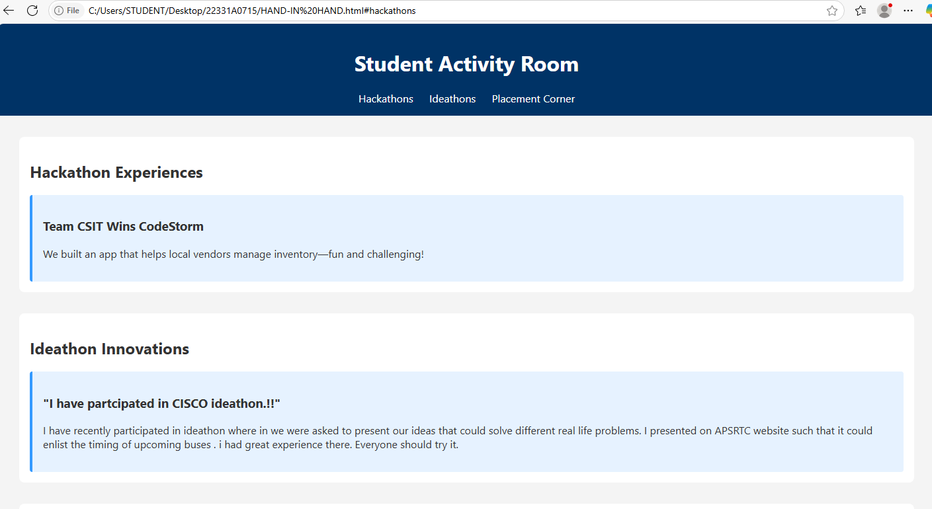
OUTPUTS:

Slide 7
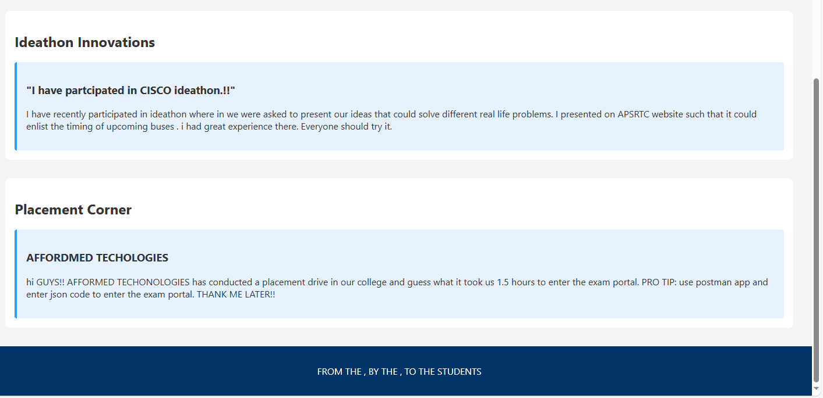

Slide 8
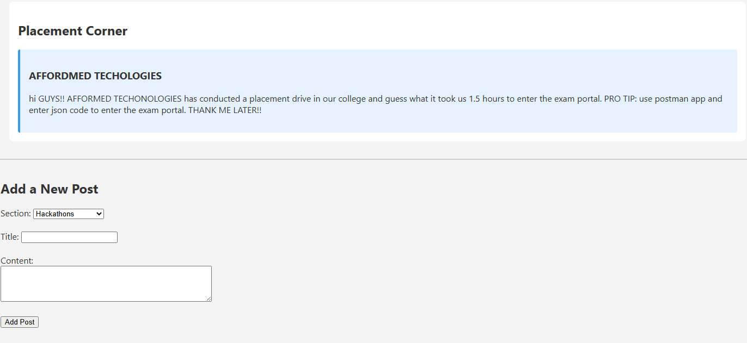
BOTTOM OF THE PAGE: AREA TO ADD NEW POST

Slide 9
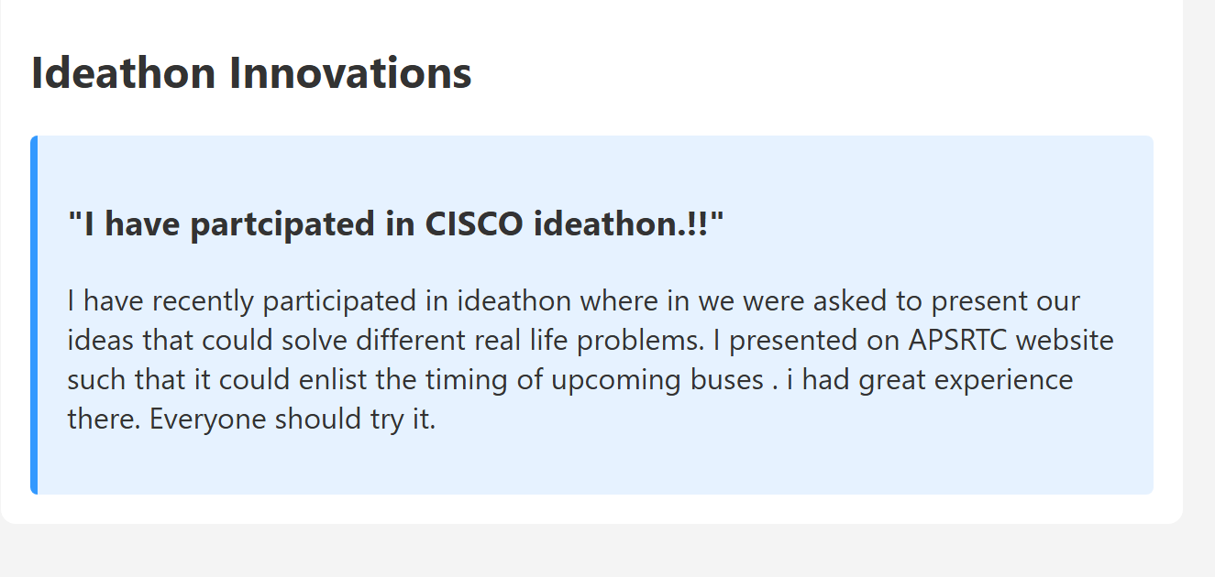
CLEAR VIEW OF THE OUTPUT:

Slide 10
GITHUB LINK:22331A0715

